Slide 1

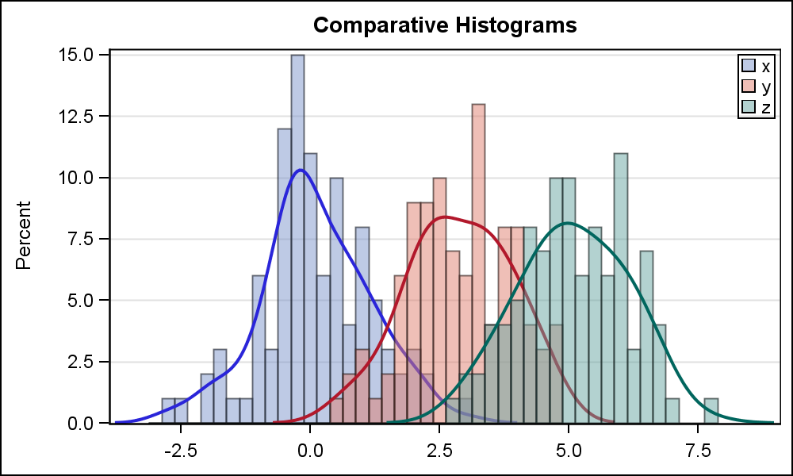
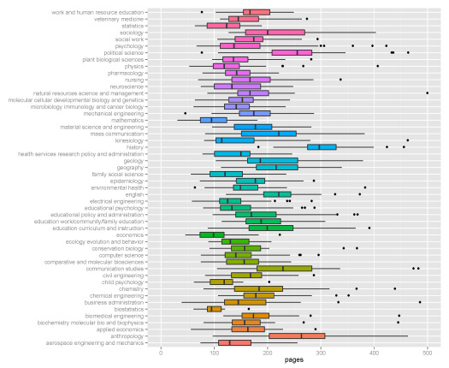
HW Assignment 2
Statistics and data analysis
Zohar Yakhini
IDC, Herzeliya
0010011101010100101010100100100010
1010100010101111101011010011001001
1110101010011010010110010110110010

Slide 2
Qn1: Data viz - practical
Use the Univ of Lyon xls provided on the course website.
Produce histograms that compare the distribution of max heart rate using all non numerical columns to partition the set of samples. State 2 conclusions you can try to draw from this analysis.
Produce a histogram that does the same for people over 50 vs people under 50.
Produce a boxplot representation of max heart rate binned according to age decades.
Produce graphical representations of the relationship between age, max heart rate and bpress
Produce a graphical representation of the best normal fit to the bpress distribution.
Produce a graphical representation of max heart rate showing F vs T blood sugar.
Identify and report 3 “interesting” trends in the data. No need to provide statistical confidence at this point. (You can use your answers to all of the above for this)

Slide 3
Qn 2: Gaussian mixtures
In this question N(μ, σ²) stands for a normal distribution with mean μ and variance σ².
Fred, Mel and Sid are repair technicians who work for Randobezeq – a phone company.
Fast Fred takes time which is distributed as N(30, 25) to repair a telephone line failure at a customer’s home.
Medium Mel takes time which is N(35, 49) for the same task.
Slow Sid takes time which is N(40, 100) for the same task.
Fred is due to arrive to repair your phone at 11AM tomorrow. How confident can you be that you will be done by 11:45?
When a customer in North Randomistan orders a repair, there is a 50% chance Fred will do the work and 25% each that Mel or Sid will do the work.
What is the distribution of the duration of repair in North Randomistan?
Let Φ denote the CDF of a standard normal random variable. Use Φ to express the CDF of the duration of a repair in North Randomistan.
If the repair starts at 11AM, what is the earliest time for which the customer can assume, at a 95% certainty, that the repair will be already done?

Slide 4
Qn3: Gaussian mixtures – parameter estimation and generation
Consider the data provided in GMD.xlsx
Assume that the data comes from a Gaussian mixture distribution (GMD). Furthermore, assume that μ1=0 and that σ1=σ2=1.
The figure in the next slide depicts a histogram of the data.
Provide an estimate for the other parameters of the distribution.
Plot a graph of the pdf of the distribution you inferred. Select adequate limits for the axes for this plot and explain your decision.
Describe two ways for generating data for a GMD random variable with:
centers at μ1+3 and μ2+5
σ1=σ2=1
w1=w2=0.5
Use one of the above approaches to generate 1000 points and plot a histogram of the result (decide on bins, axes etc)
Bonus: use the other one to generate 1000 more points and draw two comparative histograms.

Slide 5
GMD histogram

Slide 6
Qn4: Normally distributed salaries
The annual salaries of employees in a large Randomistan company are approximateley normally distributed with a mean of 50,000 RCU and a standard deviation of 20,000 RCU.
What percent of people earn less than 40,000 RCU?
What percent of people earn between 45,000 RCU and 65,000 RCU?
What percent of people earn more than 70,000 RCU?
The company has 1000 employees. Do you expect that there are any employees that earn more than 120,000 RCU?

Slide 7
Qn5: Coupon collector
Let T_{N} denote the waiting time for full single coupon collection with N different equiprobable coupon types
Write code to compute the exact value of E(T_{N})
Write code to compute the exact value of V(T_{N})
Write code to exactly compute P(T₂₀>60)
Use Chebicheff to provide a bound for the probability from C and compare the results

Slide 8
Qn6: More on convolutions
Let n be an integer, not prime.
Find two distributions a and b on the nonnegative integers, both not concentrated at 0 (this is the trivial answer …), such that the convolution of a and b is the equiprobable (uniform) distribution on the set of numbers 0, 1, 2, . . . , n-1.
Note: If n is prime this is not possible, but the proof is not so easy.

